Slide 1
Robotics Lab
Lecture 3: Dh and Forward kinematics
Damascus University 2019-2020

Slide 2
DH model

Slide 3

Zs(j)
Zj
Xj
θj
Os(j)
oj
Cs(j)
αj
Cj
Zp(j)
Cp(j)
rj
Opj
Xp(j)
dj

Slide 4
Z0,Z1
X1, X0
d2
Z2
X2
d3
Z3
X3

Slide 5
Z0,Z1
X1, X0
d2
Z2
X2
d3
Z3
X3

Slide 6
Z0,Z1
r
d
X1, X0
d2
Z2
X2
d3
Z3
X3

Slide 7
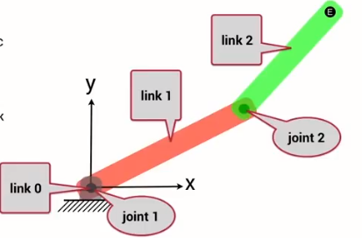
In Matlab Toolbox

Slide 8
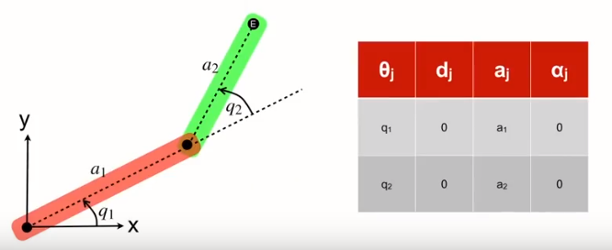
2D Joint In Matlab Toolbox
r
d

Slide 9
2D Joint In Matlab Toolbox
r
d

Slide 10
Note to create DH parameter
% Q | r | d | alpha
dh = [
0 0 1 0
0 0 1 0
]
%%
r = SerialLink(dh)
%%
r.teach
%%
r.plot([0 0])
%%
p = r.fkine([0 0])
%%

Slide 11
Note to control motor
1- to init the arduino use :
a = Arduino1('COMx’)
#replace x with a number you can find in arduino IDE, or in device manager
2- before removing the arduino use:
close_arduino(a)
3- to control motors use:
moveMotor(a, motor number , angle)
note:
motor numbers in the 2d arm: 1 , 2 respectively

